Slide 1
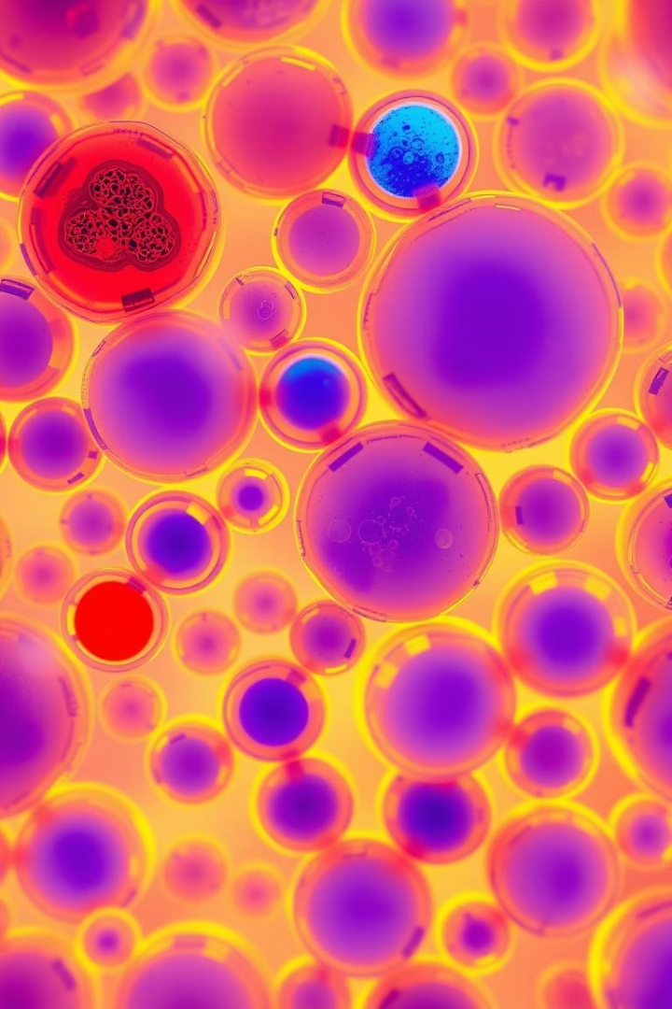

Breast Cancer Diagnosis Prediction
This presentation explores using machine learning to classify breast tumors as malignant or benign. We leverage diagnostic features extracted from cell nuclei. Our goal is to develop an accurate predictive model for medical diagnostics.
by Shubham Raut

Slide 2




Project Overview and Setup
Import Libraries
Essential libraries for data handling, visualization, and modeling.
Load Dataset
Loading the breast cancer dataset for analysis.
Explore Data
Initial checks on shape, data types, and null values.
We begin by importing necessary Python libraries. These include pandas for data manipulation, numpy for numerical operations, matplotlib and seaborn for visualization, and scikit-learn for machine learning tasks. Next, the dataset is loaded, and a preliminary exploration is performed to understand its structure and content.

Slide 3
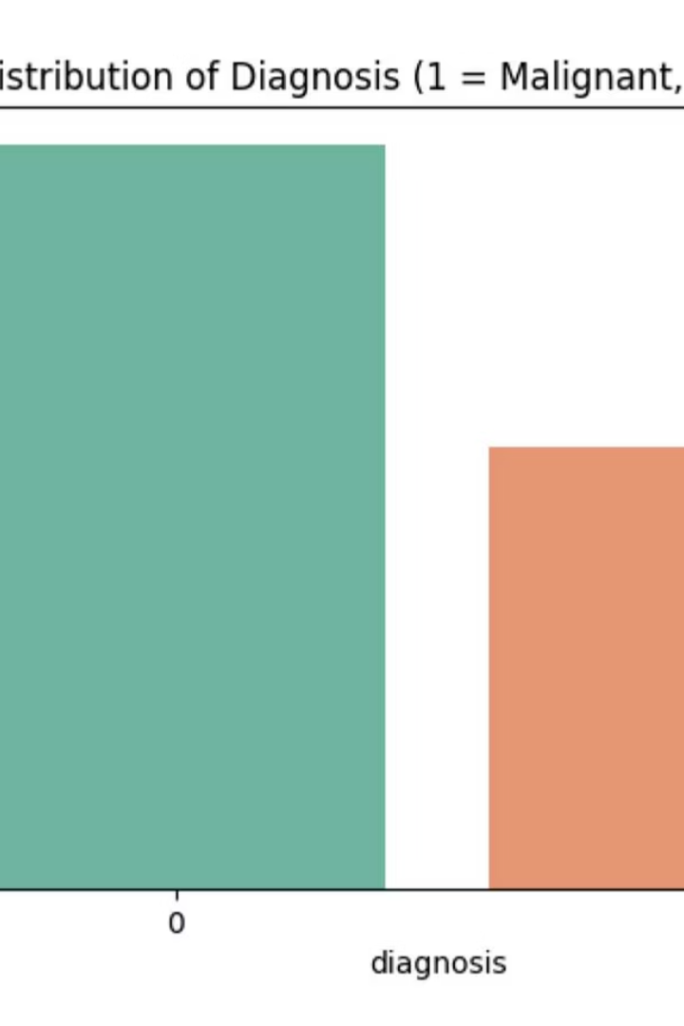
Data Cleaning and Preprocessing
1
Drop Unnecessary Columns
Removing 'id' and 'Unnamed: 32' columns.
2
Encode Target Variable
Converting 'diagnosis' to binary (M=1, B=0).
3
Check Class Balance
Analyzing the distribution of malignant vs. benign cases. The dataset shows a class imbalance favoring benign cases.
4
Final Data Check
Verifying for missing values and duplicates.
This stage involves refining the dataset. We removed irrelevant columns and encoded the target variable, 'diagnosis', into a numerical format. We observed a class imbalance, which is crucial for model evaluation. Lastly, we performed a final check for data integrity.

Slide 4
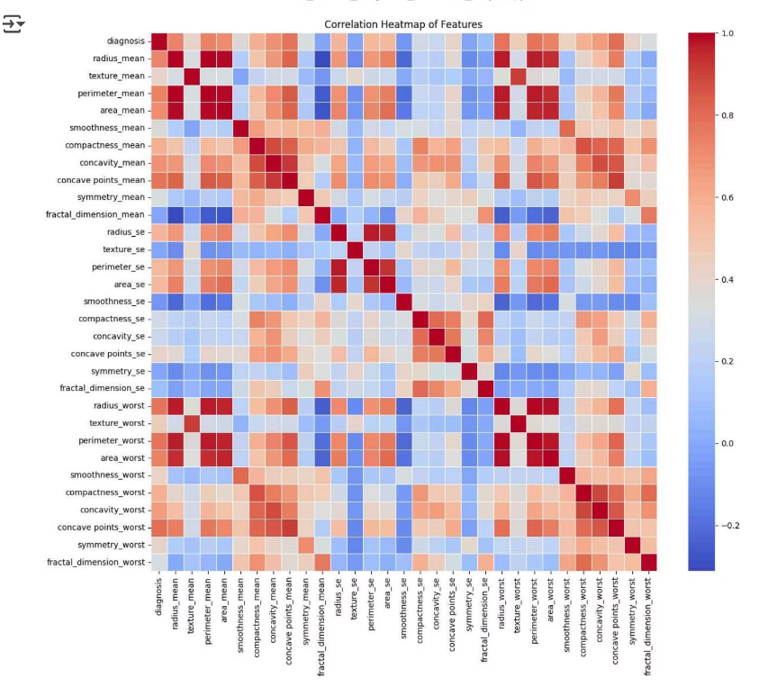
Exploratory Data Analysis: Feature Correlations
Strong Positive Correlations
Features like radius_mean, perimeter_mean, area_mean, concavity_mean, and concave_points_mean show strong positive correlations with diagnosis. These features increase significantly with malignant tumors. This indicates their high predictive power for malignancy.
Weaker Correlations
Features like smoothness_mean and fractal_dimension_mean have weaker or negative correlations. This suggests they have less influence on the diagnosis. Understanding these relationships is vital for feature selection.
The correlation heatmap reveals strong relationships between specific features and the diagnosis. Key features such as radius, perimeter, and area tend to increase with malignancy. This suggests these metrics are highly influential in distinguishing between benign and malignant tumors.

Slide 5
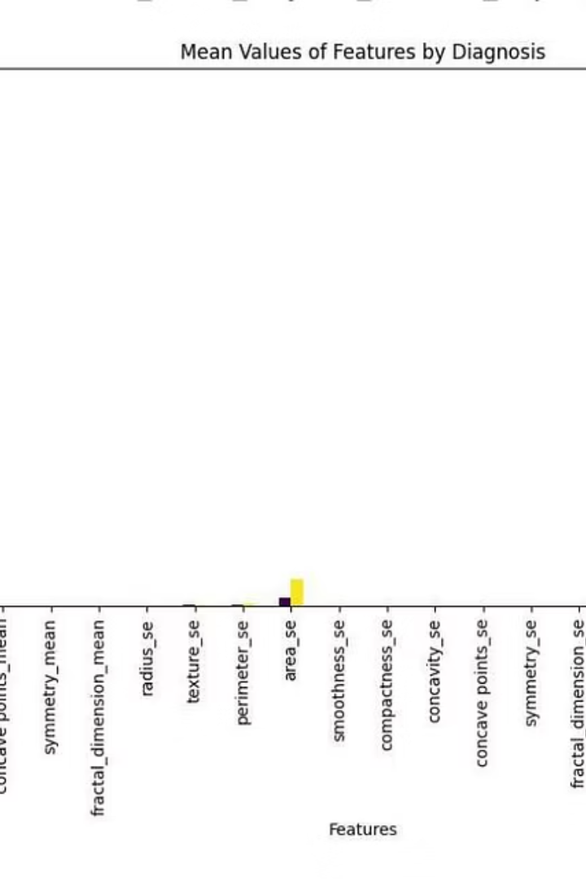
Feature Distribution by Diagnosis
1
2
Area Mean
Radius & Perimeter
Consistently higher in malignant tumors.
Larger for malignant tumors.
3
Concavity & Compactness
Higher in malignant tumors, indicating irregularity.
Malignant tumors consistently exhibit higher mean values across most features. Features like area and perimeter show drastic differences, indicating tumor size as a critical differentiator. Irregularity features, such as concavity and compactness, are also significantly higher in malignant cases.

Slide 6
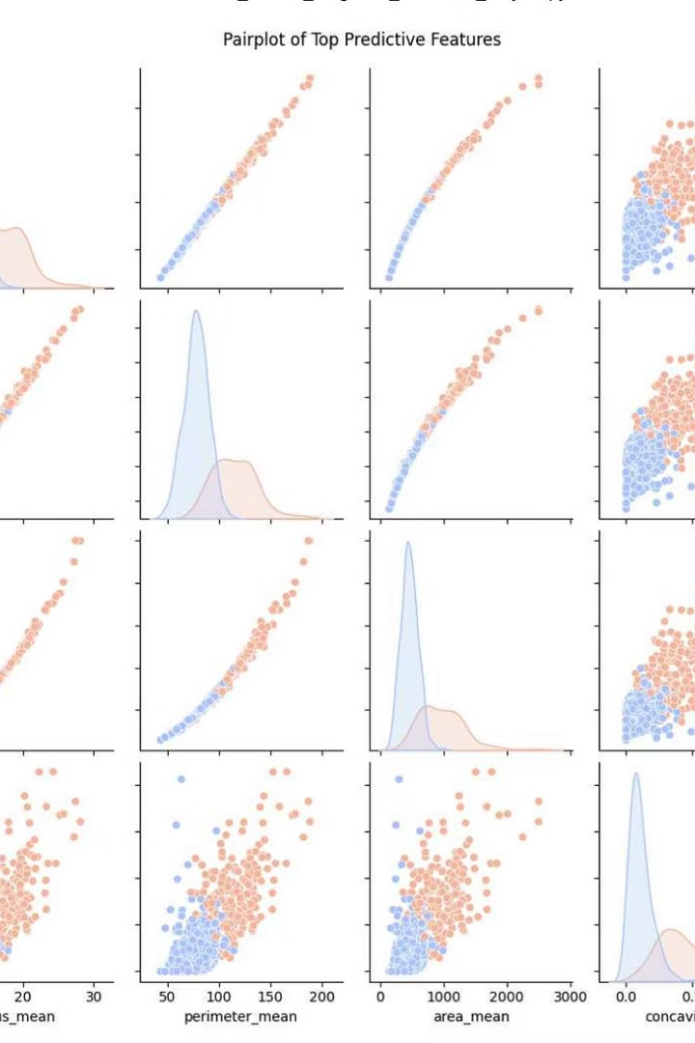



Pairplot of Top Predictive Features
The pairplot visually confirms strong class separation between malignant and benign tumors based on top predictive features. Malignant tumors consistently show higher values for radius_mean, perimeter_mean, area_mean, and concavity_mean.
Clear Class Separation
Strong Positive Correlation
Malignant tumors (orange) cluster at higher values for key features.
Radius, perimeter, and area show high linear relationships.
Concavity Mean Value
Especially useful for distinguishing between classes due to distinct clustering.

Slide 7
Model Building and Evaluation
We trained and evaluated two supervised machine learning models: Logistic Regression and Random Forest Classifier. Both models were assessed based on accuracy, confusion matrix, and classification report. The dataset was split into training and testing sets, with stratification to maintain class balance.
Logistic Regression
Random Forest Classifier
Accuracy: 0.939
Accuracy: 0.974
[[71 1] [ 6 36]]
[[72 0] [ 3 39]]
The Random Forest Classifier outperformed Logistic Regression, achieving a higher accuracy. Its performance in correctly classifying malignant cases (recall for class 1) is particularly strong, which is critical in medical diagnostics.

Slide 8




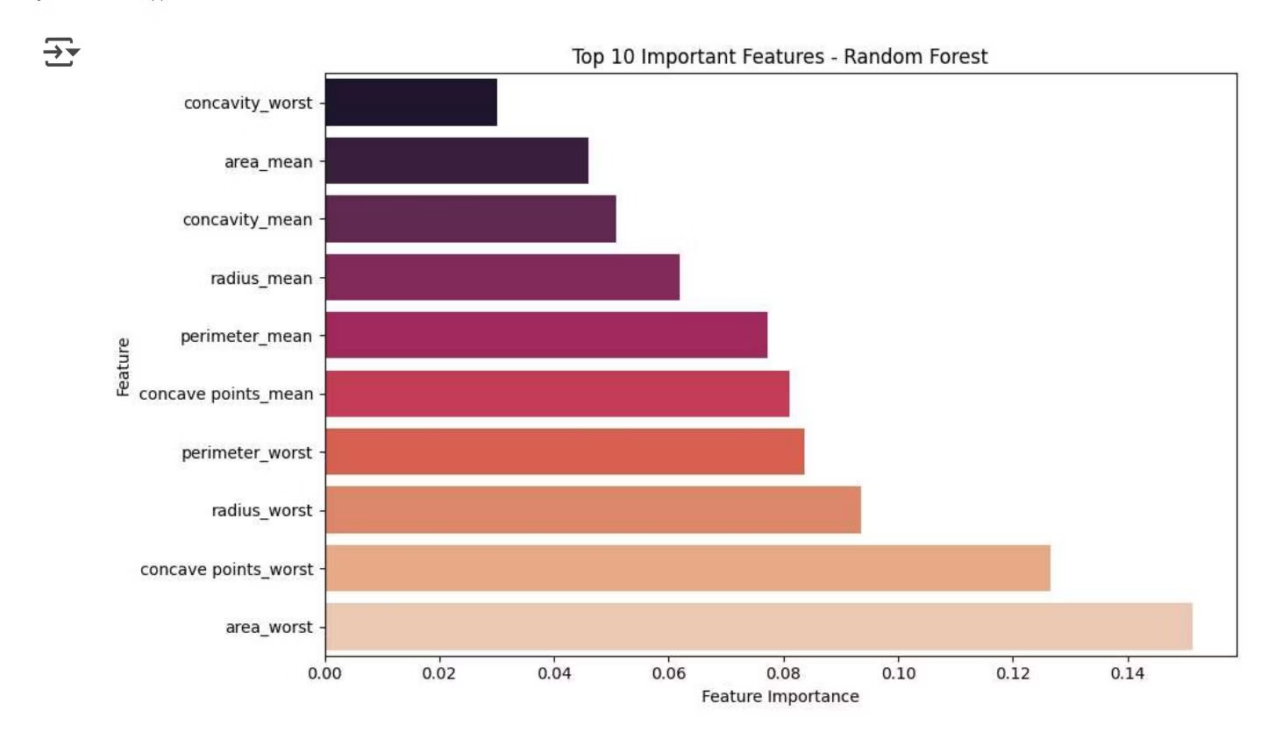
Key Takeaways and Next Steps
Our analysis identified several highly predictive features for breast cancer diagnosis. The Random Forest model demonstrated superior performance in classifying tumors.
Model Refinement
Feature Engineering
Explore advanced ensemble methods or neural networks.
Create new features from existing ones to improve model performance.
Clinical Validation
Hyperparameter Tuning
Collaborate with medical professionals for real-world testing.
Optimize model parameters for even better accuracy and robustness.
Moving forward, we will focus on enhancing model performance and preparing for practical application.

Slide 9
Final Project Overview
Project Achievements
Core Findings
Clinical Impact
We developed machine learning models. These models predict tumor diagnosis (benign/malignant). They utilize cell nuclei features.
Key features like radius and concavity mean predict malignancy. Random Forest showed superior performance. Visual analysis confirmed clear class separation.
Our models can assist doctors in early diagnosis. They enable automated triage of cases. Critical diagnostic metrics are also highlighted.

